Slide 1

Columbia University
Data Analytics & Visualization Bootcamp REAL LEADS GROUP
Members: Adam Karim, Deanna Centi, Stefanie Centi, Hande Demir-Neilan, Madeline Propis, Vince Trombetta

Slide 2

Approach
The Real Estate sector is a significant part of the economy
Created a real-world simulation
Established a hypothetical company called RealLeads
RealLead’s initial product was targeted for agents
Provides Agent Leads
Customer Relationship Management
Agent leads are generated via a machine-learning algorithm that uses public record, multi-list service, and APIs
Notes:
The team decided to approach the project by creating a real-world simulation. We established a hypothetical company called RealLeads, which is a real estate focused fintech company that matches agents with home sellers.
RealLeads has been in business for about five years. Their initial product was the “RealLeads Agent Console”, a portal that serves up home seller leads and also acts as a CRM (Customer Relationship Management) database for agents. Company revenue is partly subscription-based for the CRM/portal, but there is also a cost-per-lead, and agents may purchase as many leads as they would like in a given month subject to availability. Leads are generated via a machine-learning algorithm that uses public record, multi-list service, API and proprietary data from agents. Leads are ranked by quality (likelihood to convert), and higher quality leads cost more. Agents may pick which quality tier they want in any given month and also purchase on a per-lead-basis

Slide 3
Next phase:
Investors now want to see product expansion and increased revenue
New idea needs to be monetized
Our team proposes creating a new portal targeted at home sellers - this is called ”Homewise powered by Real Leads”
Our mission today is to share a presentation to executive management which:
Positions the new product
Discusses data/ETL process
Presents a machine learning approach
Offers a live demonstration of the product
Notes:
Now that RealLeads has been in business successfully for five years, investors want to see product expansion and increased revenue. Our RealLeads data and product development team has been tasked with coming up with a new idea that can be monetized.
After some brain-storming and careful thought over the past several weeks, our team proposes creating a new portal, this time targeted at retail clients themselves. The portal, “RealLeads Homewise”, will help home sellers get a sense of at what price they might list their home for, what to expect for a sold price, and also get a sense of the number of days a home can be expected to stay on the market. The tool will capture user data which can be monetized by RealLeads, and there is also a click to call/email feature that puts the Seller/user in touch with an agent who pays for the lead, and provides an additional revenue source for RealLeads.

Slide 4
Product Positioning
>80% of home sellers use internet
Most competitors capture home buyer information and sell leads to agents
“Homewise powered by RealLeads” targets the home seller and provides information the others do not:
Suggested List Price
Expected Sold Price
Expected Days on Market
Machine Learning models are a competitive advantage

Slide 5
Product Positioning
Home Sellers have the option to contact an agent through the Homewise portal
Home Sellers are asked to provide contact information
Home Seller contact information is sold to agents
They can also opt-into marketing, which can also be monetized by RealLeads
Notes:
The RealLeads Homewise portal allows home owners to enter an MLS number, which then calls up information about their home from past listings and the public record. The home owner can then edit the information for any recent changes, such as an addition or renovations.
Once the home owner has approved all the inputs, they click enter, and a Machine Learning model takes the inputs and generates a suggested list price based on similar homes and features. There are separate ML models that will estimate the expected Sold Price, and the number of Days on Market (DOM).
Home Sellers have the option to contact an agent right then and there through a click to call/text/email feature, or they opt for a call-back. If they don’t want an agent to contact them, they can indicate so. They are asked to provide contact information for opt-in marketing, which can also be monetized by RealLeads.

Slide 6
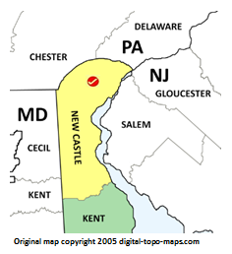
New Castle County – Housing Statistics
New Castle County is our product dev location
It is a microcosm of the US with varied land use:
Wilmington - urban center
Newark – college town
Greenville, Bellfonte – suburban communities
Middletown – new construction
Agriculture – 21%
Other
Port of Wilmington
Parkland – 6k acres

Slide 7
New Castle County – Housing Statistics
Population - 550k
Households - 200k
Annual Sales /Turnover* (2.3%) – 2,800
Housing Units - 199k
Owner Occupied (60%) - 119k
* - sold priced between $200-$600k

Slide 8
New Castle County – Size of Housing Market *
Housing Units - 199k @ $325k avg = $65 B
Annual Sales /Turnover 2,800 = $1 B
Owner Occupied 119k = $40 B
* - sold priced between $200-$600k

Slide 9
Data Sources, Extract-Transform-Load
Data Source | Property ID | Owner Info | Property Attributes | Tax Data | Sales Data | Location Lat / Lng | Other
Public Record | ✓ | ✓ | ✓ | ✓
Multi-List Service | ✓ | ✓ | ✓ |  | ✓
Google Maps - API | ✓ |  |  |  |  | ✓
Mortgage Data | ✓ | ✓ |  |  |  |  | ✓
Census Data |  |  |  |  |  |  | ✓

Slide 10
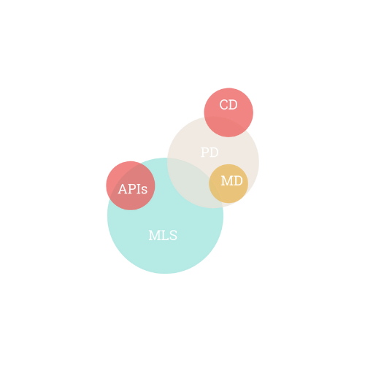
Data Sources, Extract-Transform-Load
ETL Processes
Data Source Identification
Data Scope
2 years Annual Sales or 5,600 records (2021/22)
Data Extraction into .csv
Cleansing
Reformatting
Field Selection
Establish PostgresSQL Database
Establish SQL Tables
Import Data into SQL from .csv
Tables use MLSNumber as primary key
Connections from Python using psycopg2

Slide 11
Machine Learning Overview
Supervised Learning
Unsupervised Learning
Predict List Price
Finding Correlation within the data
Predict Sold Price
Predict Days on Market

Slide 12
Supervised Machine Learning Preprocessing
Provide clean and accurate data to the machine learning model
Import tables from local database
Merge relevant tables together and drop any unnecessary columns
After dropping and cleaning the data, we went from an average of 55 columns to only 20 relevant columns to use for the machine learning model.
Split data in an 80/20 ratio
80% will be used for training
20% will be used for validation
Notes:
The first step to creating machine learning models is to provide clean and accurate data to the model. If the data is not cleaned or is innacurate, then the machine learning model will perform poorly and provide incorrect information. We begin preprocessing by importing tables from a local database which contains a large quantity of information related to the New Castle County housing market such as listing prices, sold prices, days on market, number of bedrooms, and much more. Once the tables are imported, we begin to merge relevant tables together and drop any unecessary columns that will not provide value to the machine learning model. Including invaluable columns in the machine learning model can break the model and/or provide very poor results. For example, if we include a column named *MLSNumber* in the machine learning model, it will not provide any insight to help the machine learning model predict prices or day on market. This is because each row contains a different MLSNumber as they are the unique identifiers that similar to an ID. After dropping and cleaning the data, we removed over 60 columns to only include relevant columns in the machine learning models.

Slide 13
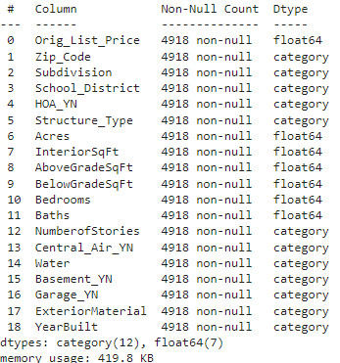
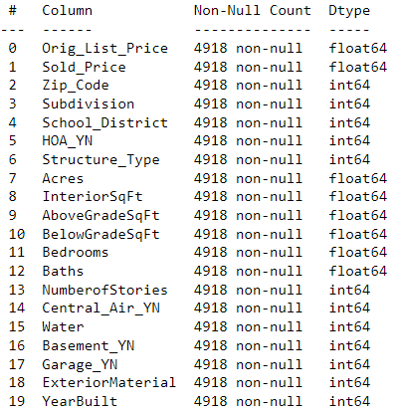
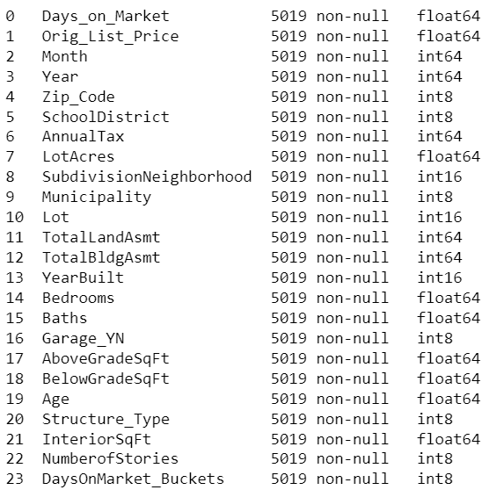
Supervised Machine Learning Columns Used
List Price
Sold Price
Days on Market

Slide 14
Supervised Machine Learning Predicting List Price
Unscaled Model | Accuracy Score
Random Forest Regressor | 77%
Ridge Regression | 55%
Linear Regression | 60%
Lasso | 60%
Elastic Net | 58%
Bayesian Ridge | 60%

Slide 15
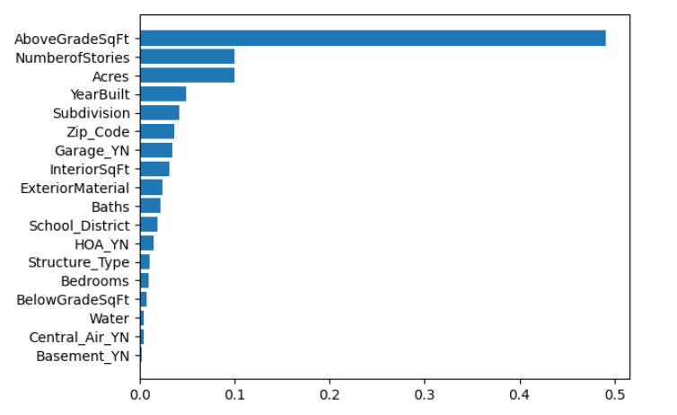
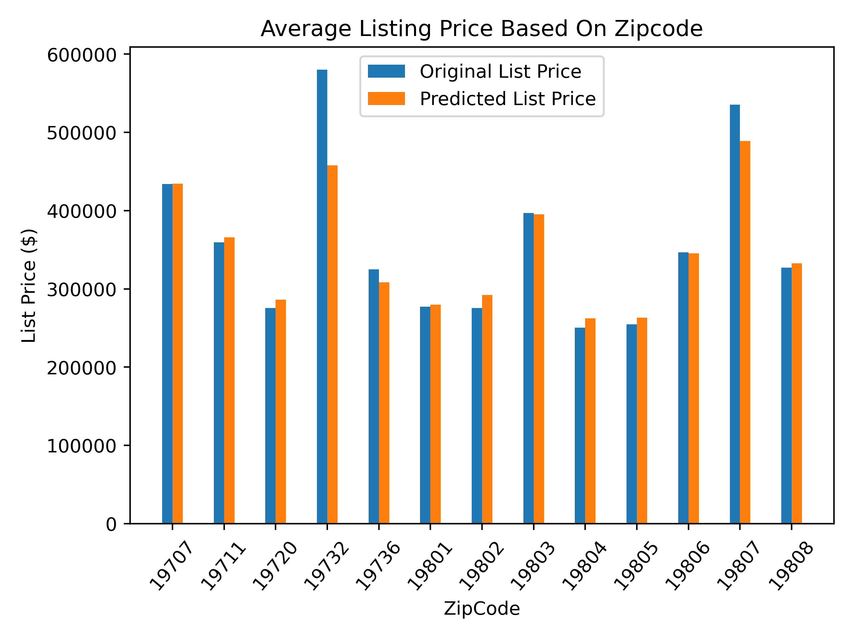
Supervised Machine Learning List Price Prediction Results
Random Forest Regressor
Regression model
Retraining on random states
Built-in functions
StandardScaler
Mean = 0 and SD = 1
Model accuracy: 75%

Slide 16
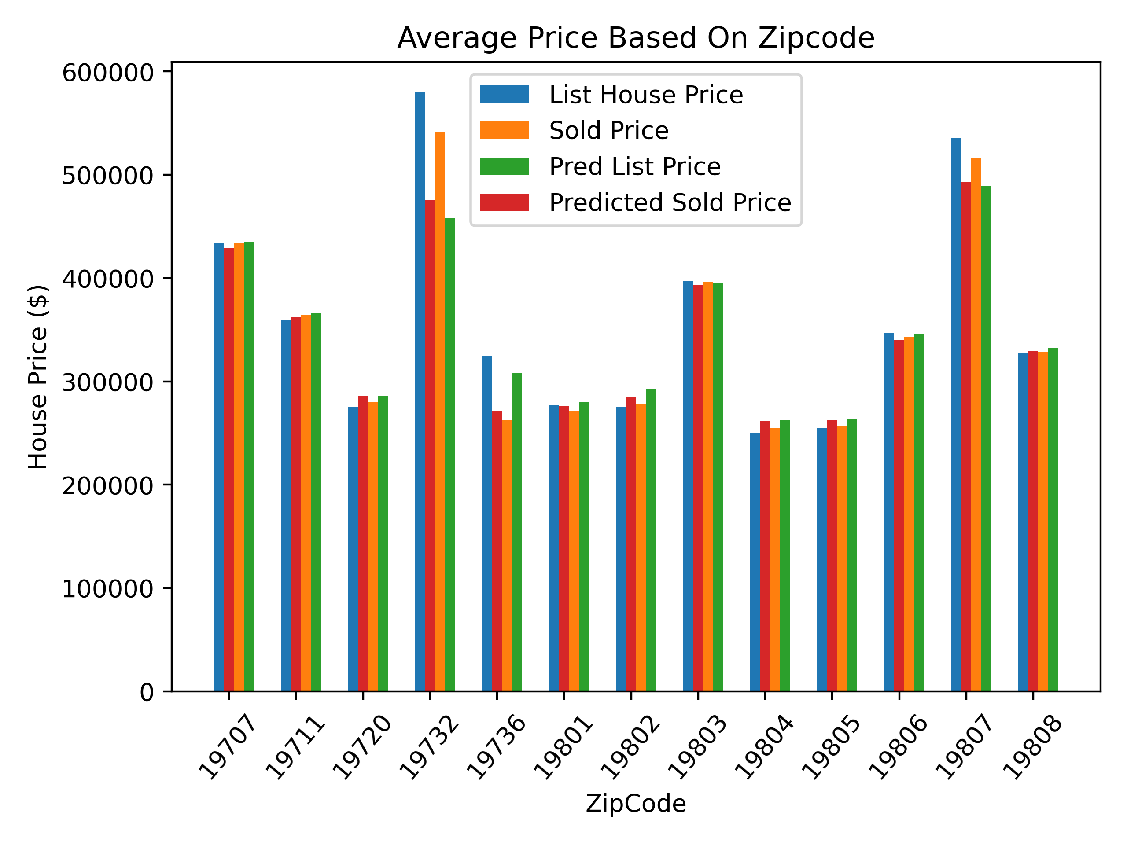
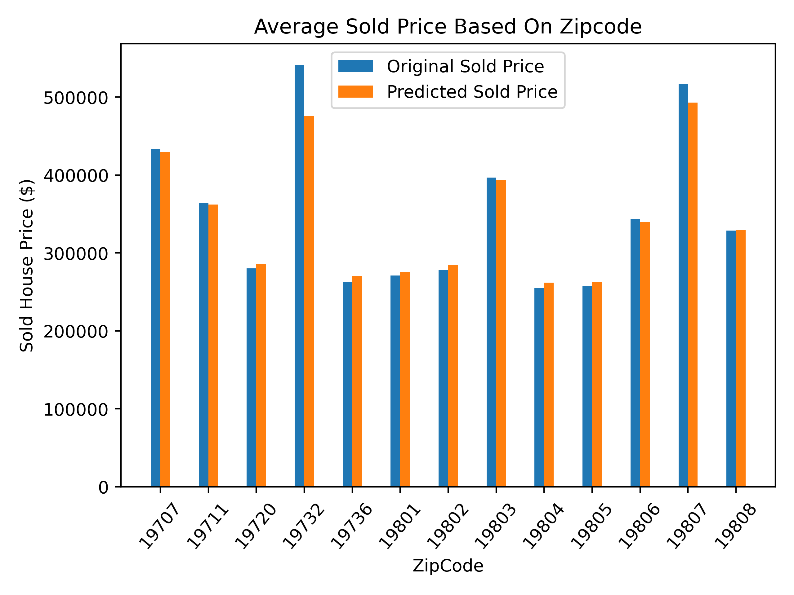
Supervised Machine Learning Sold Price Prediction Results
Random Forest Regressor
Regression model
Retraining on random states
Built-in functions
StandardScaler
Mean = 0 and SD = 1
Model accuracy: 86%

Slide 17
Supervised Machine Learning Predicting Days on Market
Model | Balanced Accuracy Score
Balanced Random Forest Classifier | 63%
Balanced Random Forest Classifier (with dropped columns) | 70%
Easy Ensemble Classifier | 44%
Easy Ensemble Classifier (with dropped columns) | 37%

Slide 18
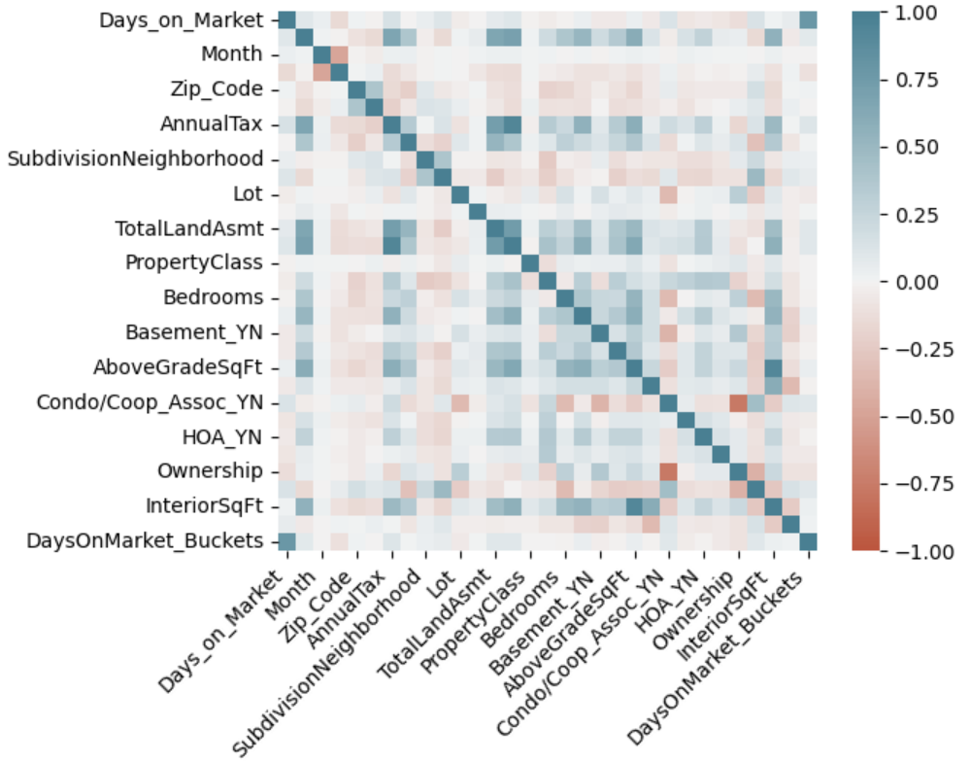
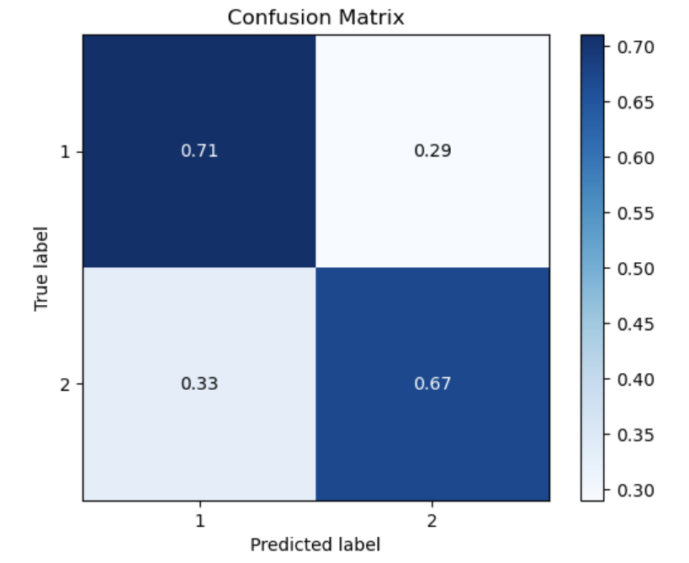
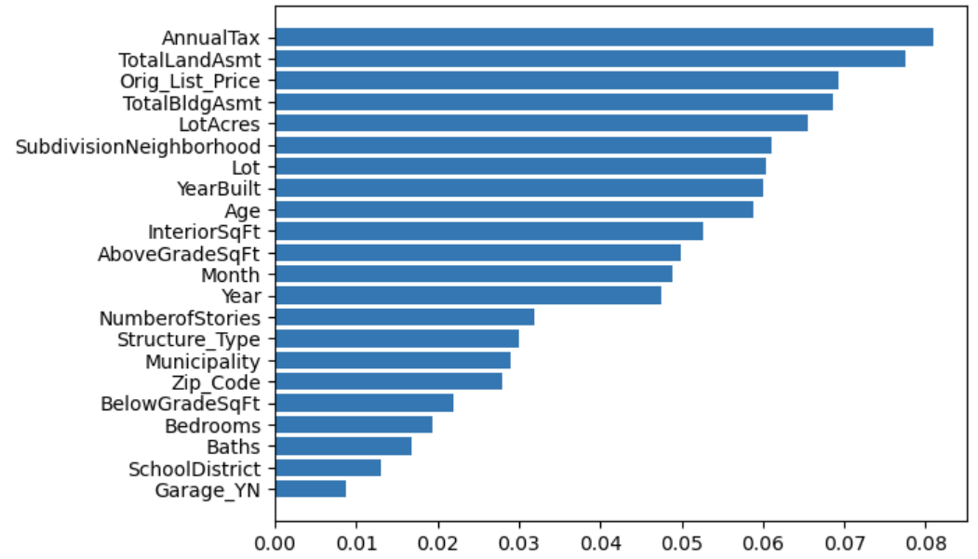
Supervised Machine Learning Days on Market Prediction Results
Balanced Random Forest Classifier
Classification model
Retraining on random states
Built-in functions
Bucketing
Less than/more than 2 months

Slide 19
Machine Learning Unsupervised Learning
Determine any correlation with the data points using
Different data table compared to the supervised machine learning model
Included majority of columns of data
Principal Component Analysis (PCA)
Dimensionality reduction
Normalization

Slide 20
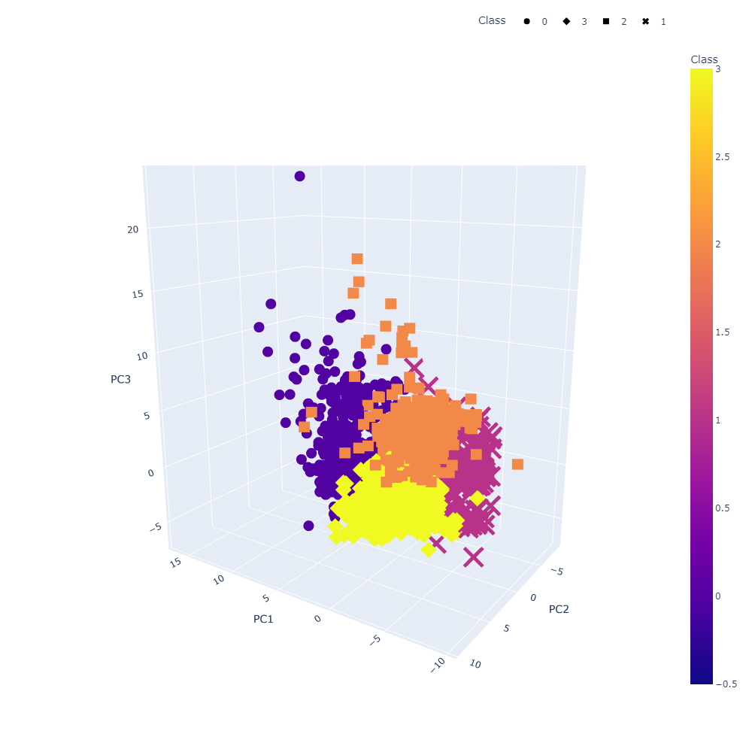
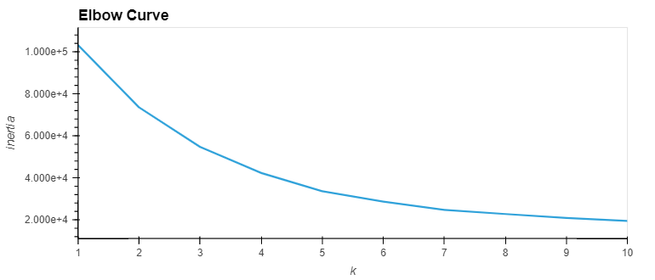
Unsupervised Learning K-Means Results
Determine any correlation with the data points using
Different data table compared to the supervised machine learning model
Included majority of columns of data
Principal Component Analysis (PCA)
Dimensionality reduction
Normalization

Slide 21
“RealLeads Homewise” prototype
How prototype is built (need to decide which tools)
Python
Flask Routes
WTForms/JavaScript/HTML
CSS
Plotly
Current Functionality
Uses Home Listings pulled from the Machine Learning Algorithms
Shows estimates from the MLs for list price, sold price, DOM
Future Enhancements
Complete Connectivity to MLS & public record data
Enhance User Interaction Integration with the ML models
Enhance Map and Data Retrieval to Give an Improved User Experience
Click to call, email, text to connect with an Agent

Slide 22
Next Steps / Q&A
Secure Development Funding - $1.2M
6 Analysts at $200k each per annum
Refine Models
Build out and operationalize product prototype
Launch test in New Castle County
Q&A

Slide 23
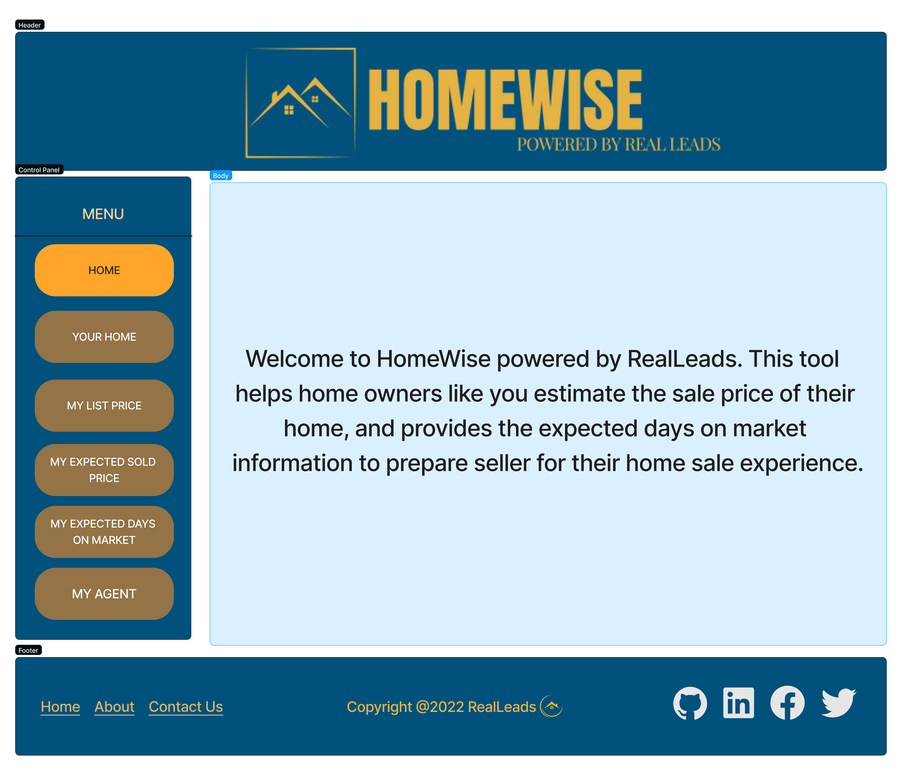

Slide 24
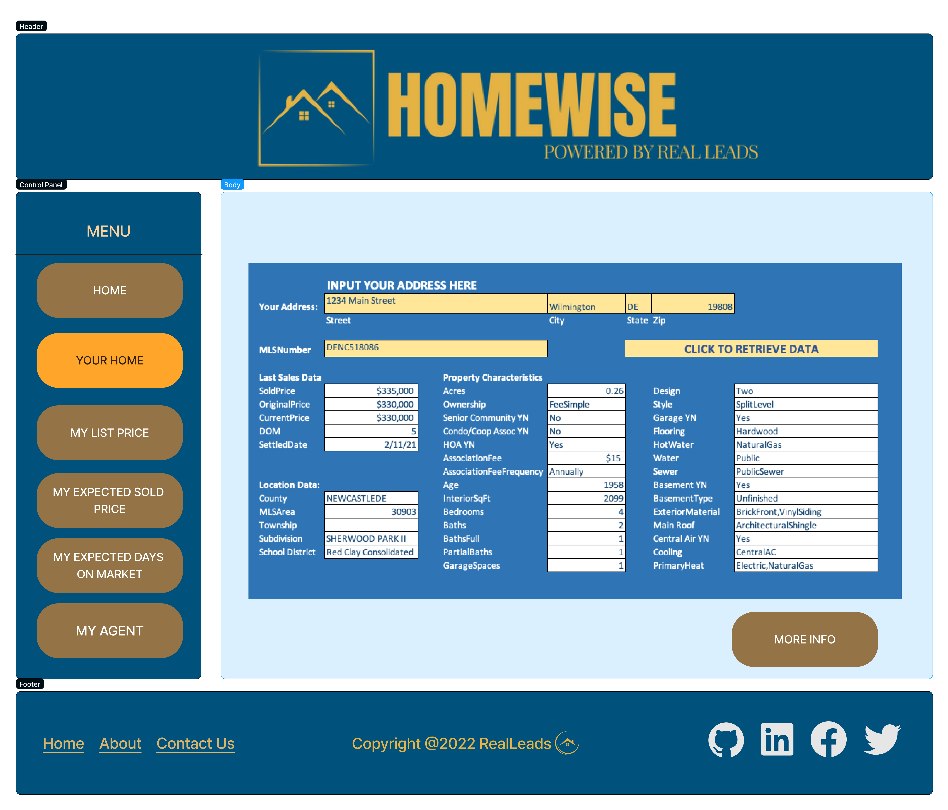

Slide 25
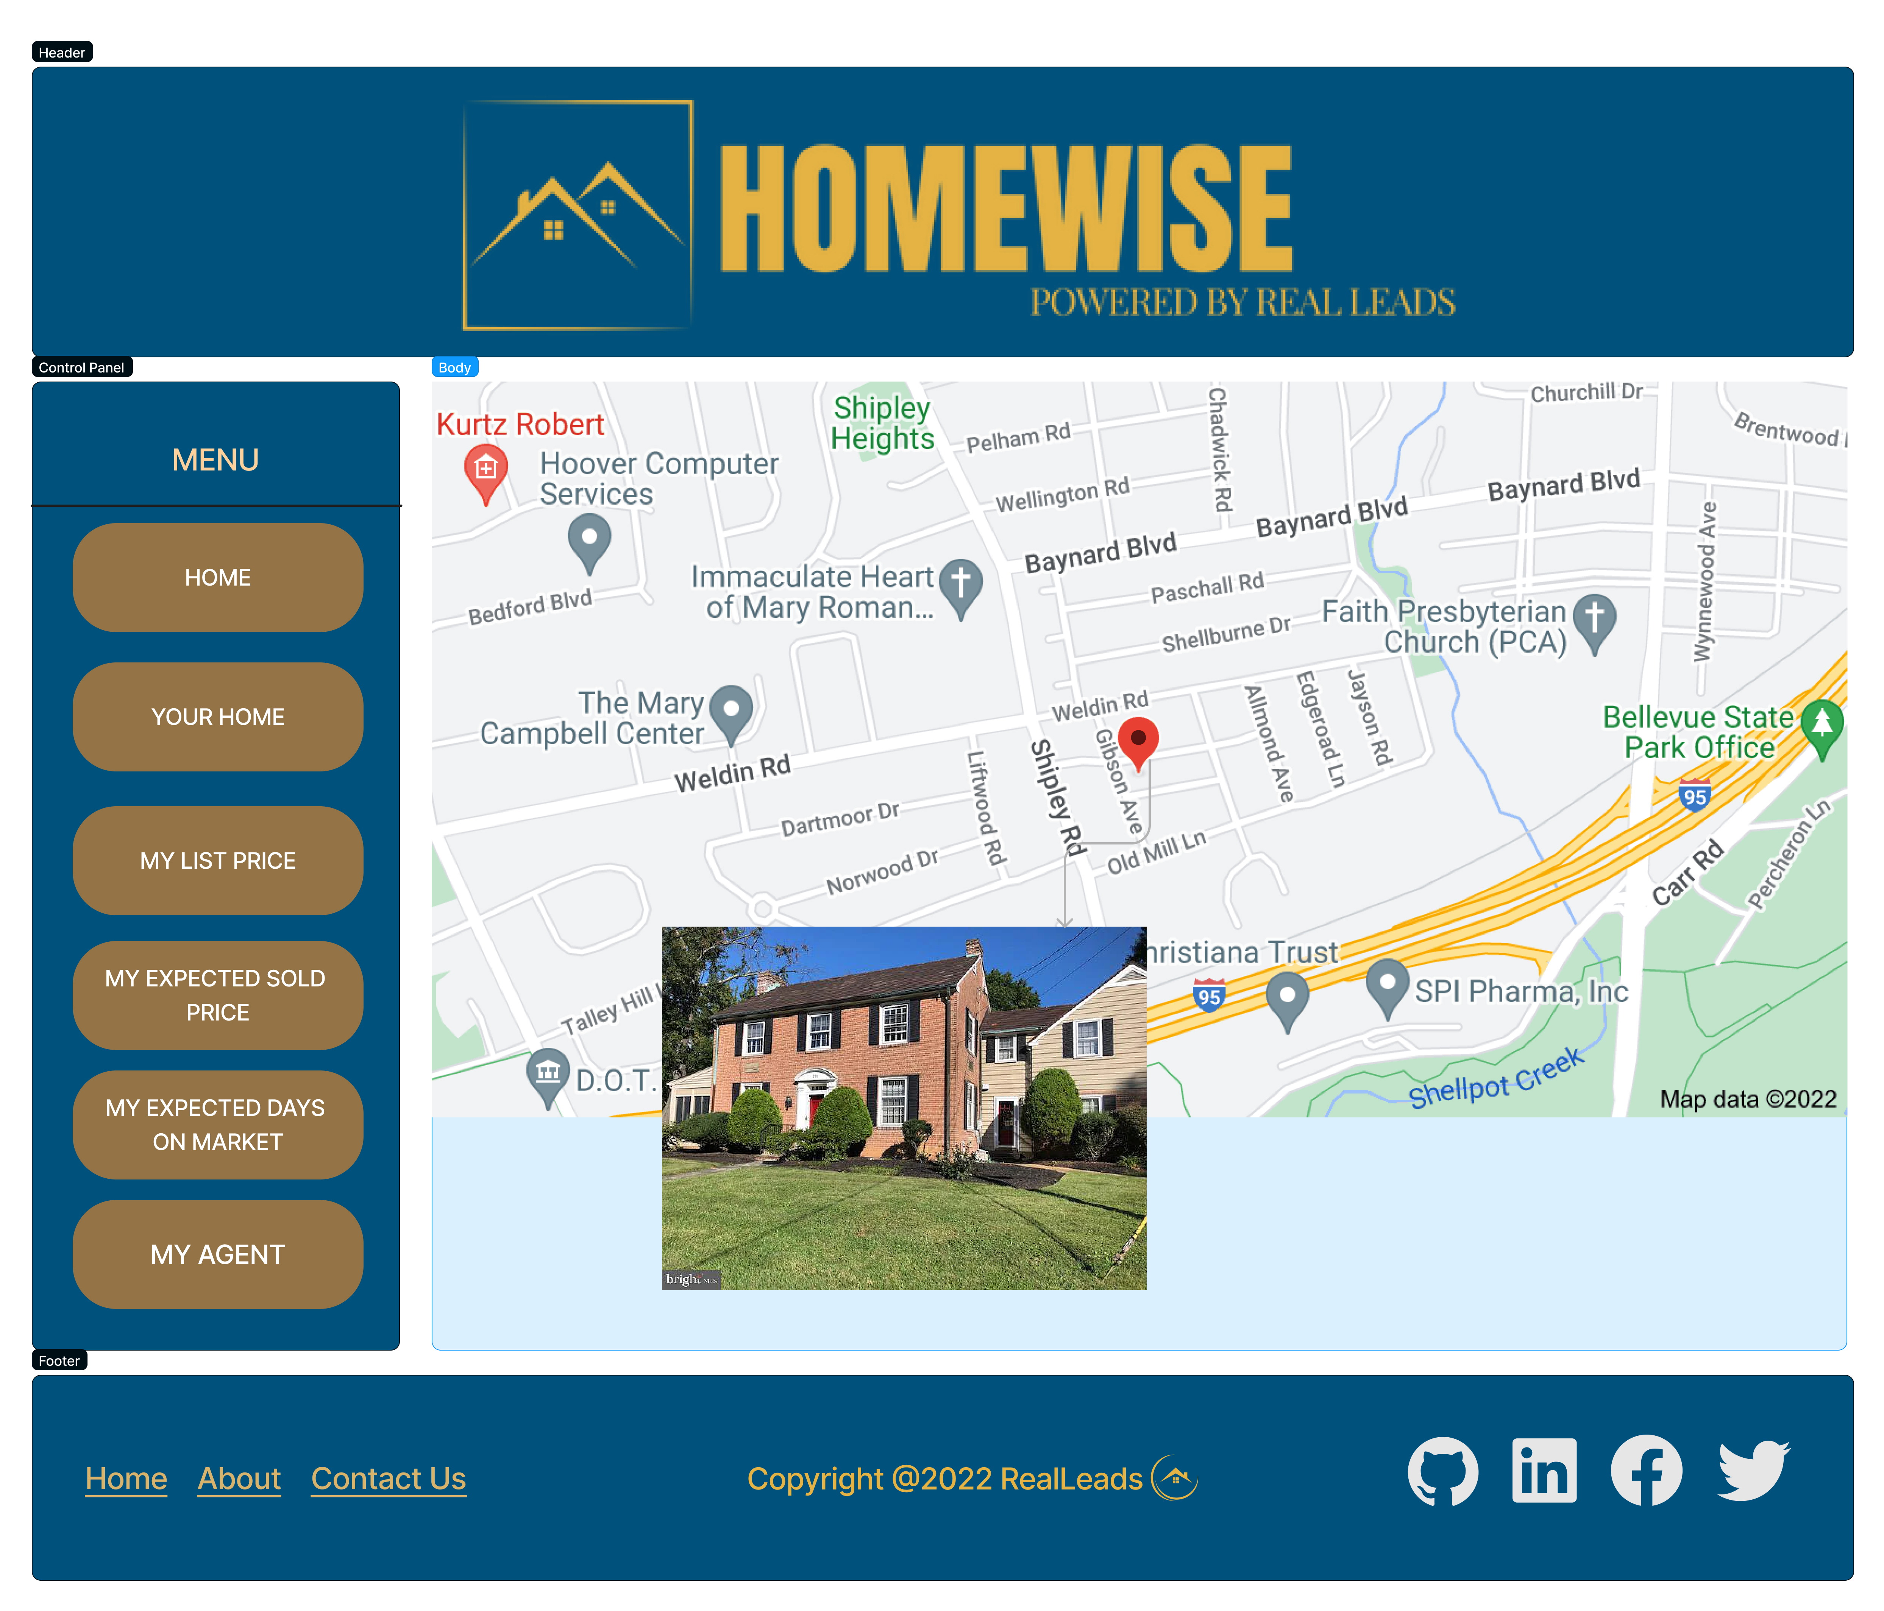

Slide 26
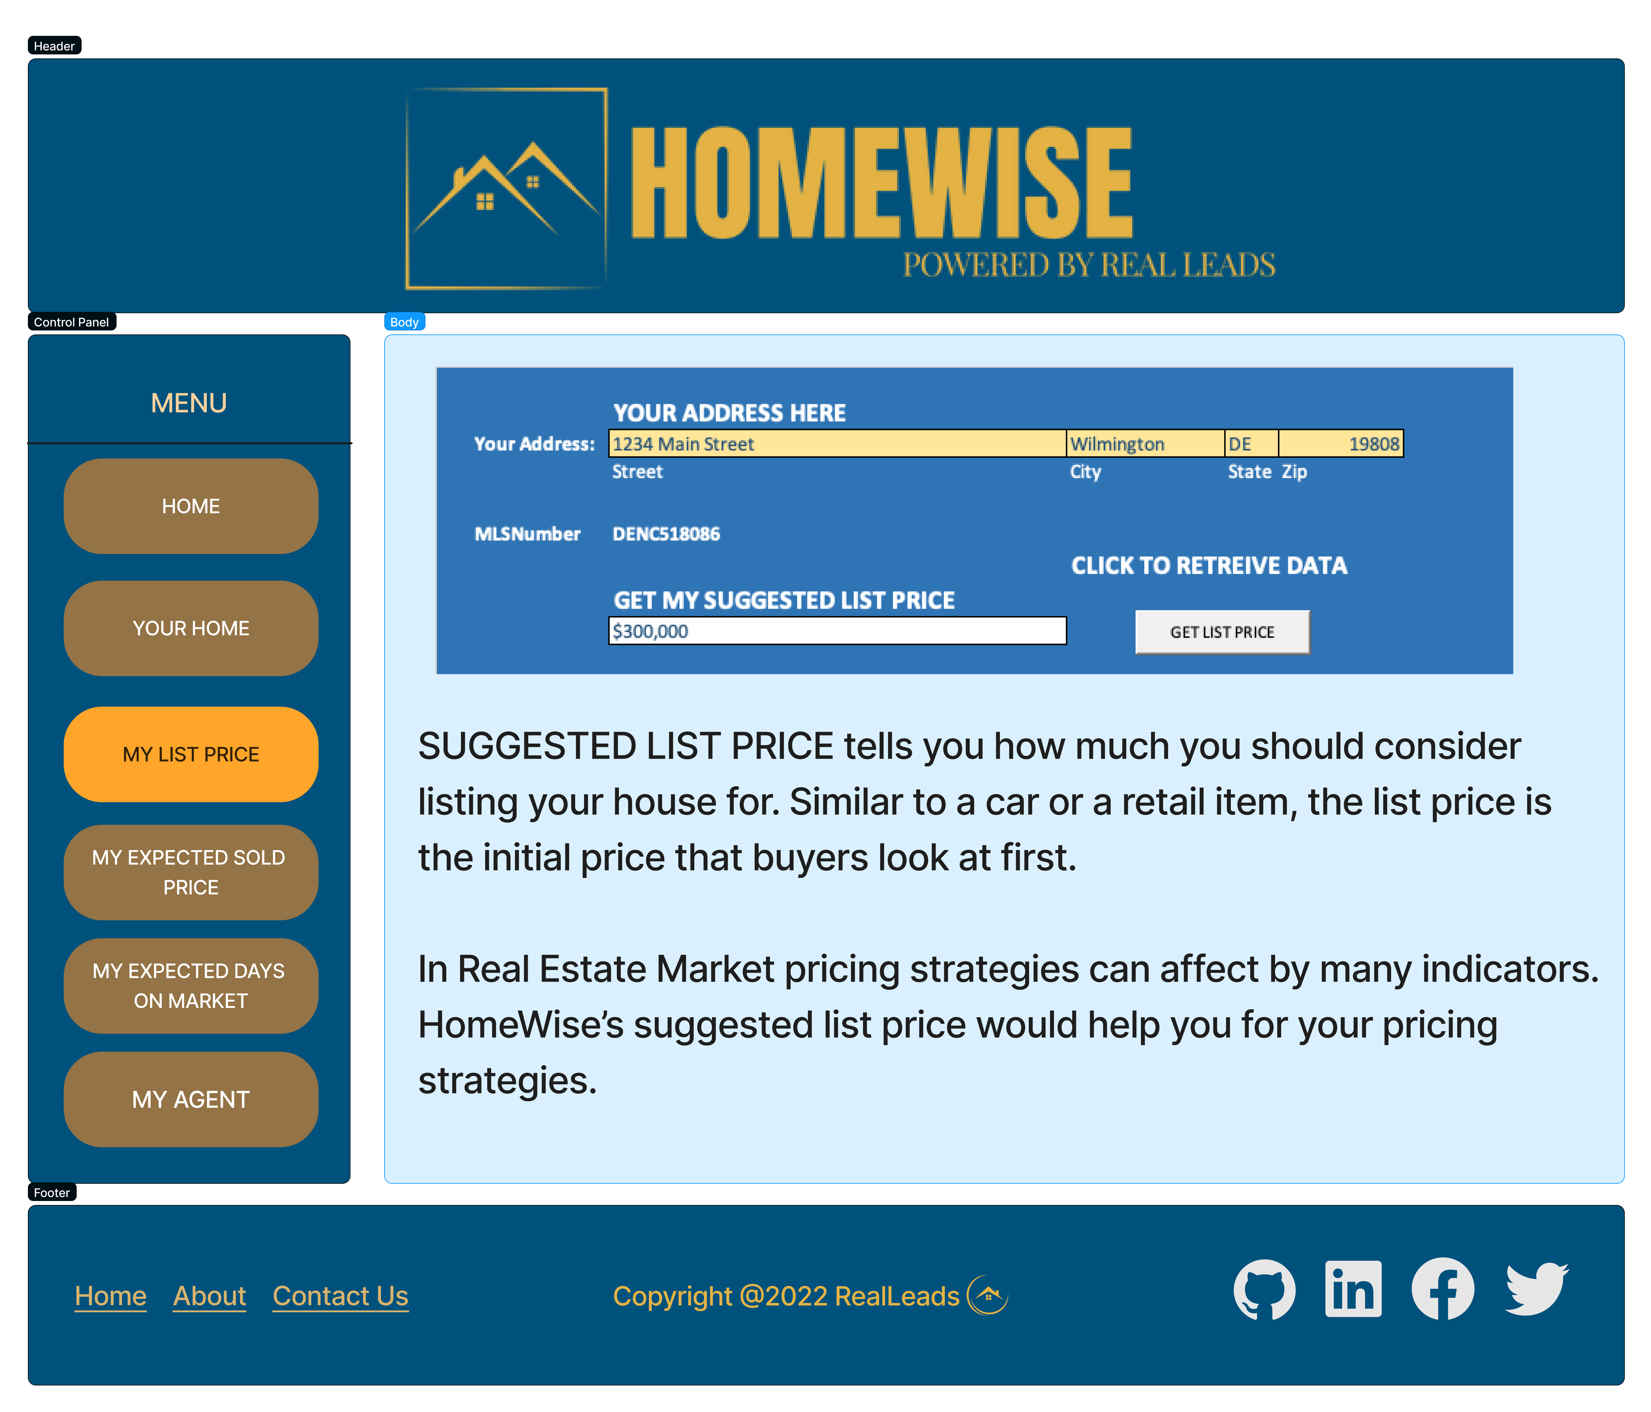

Slide 27
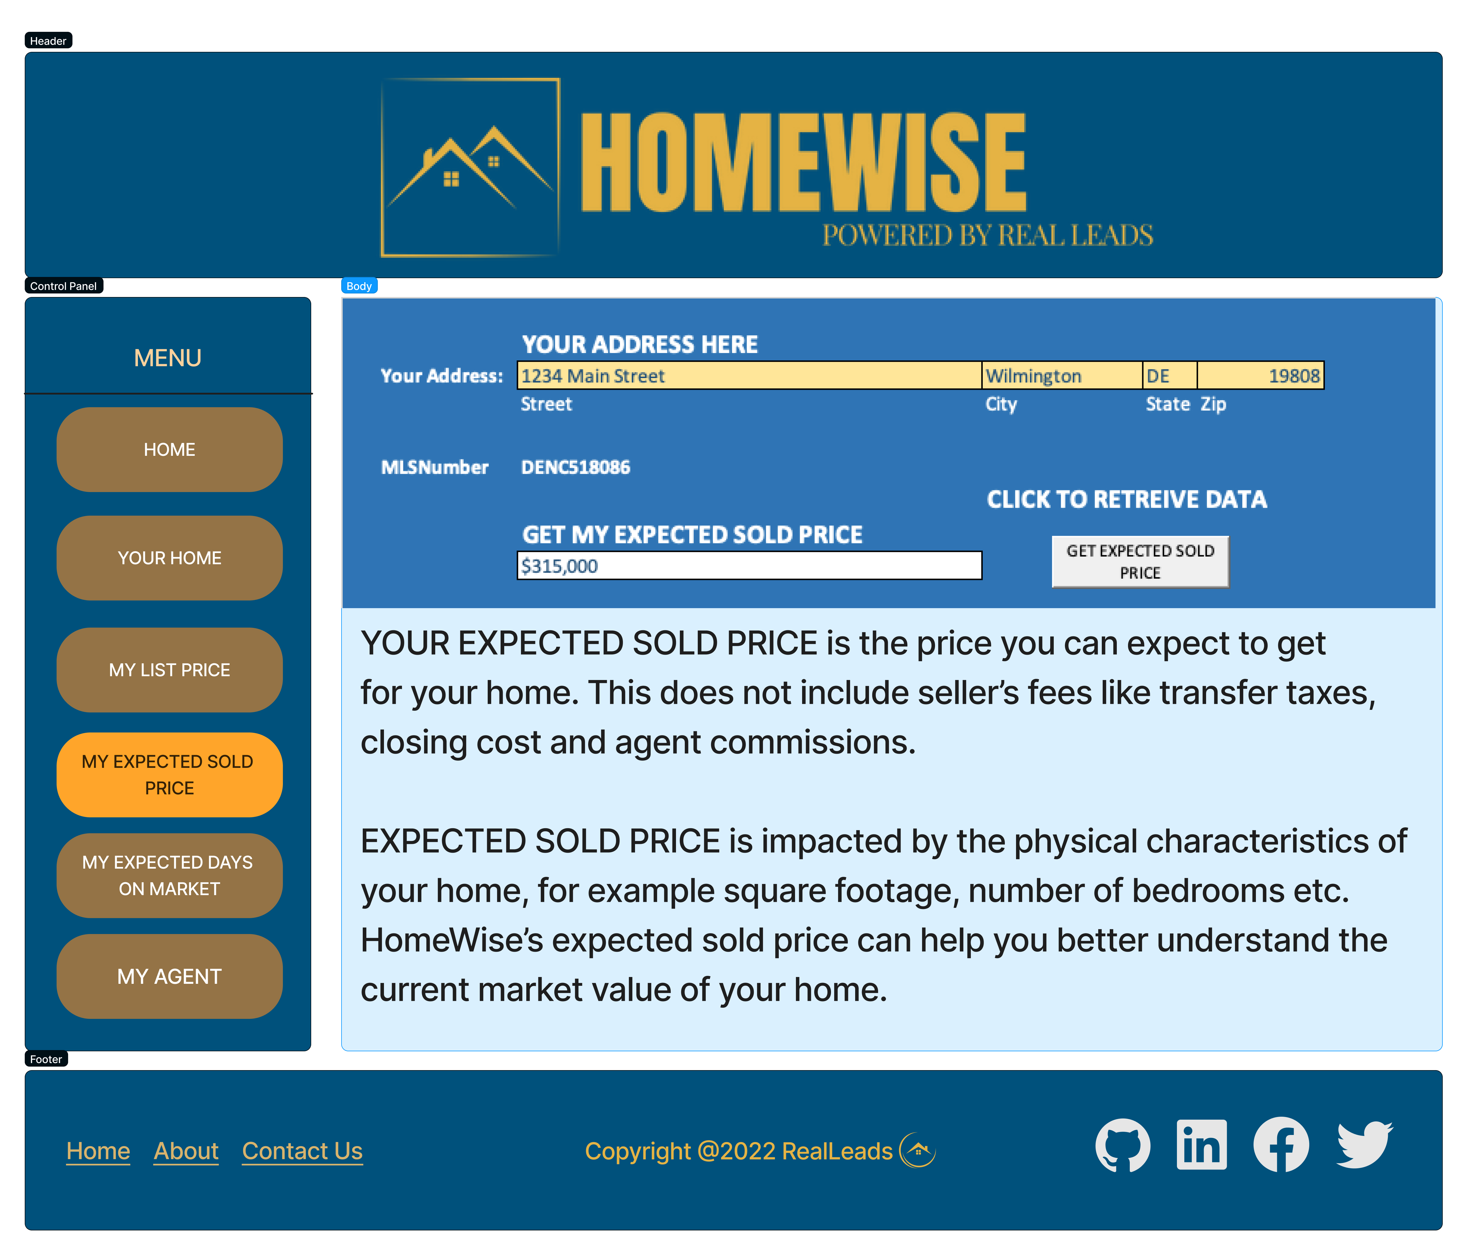

Slide 28
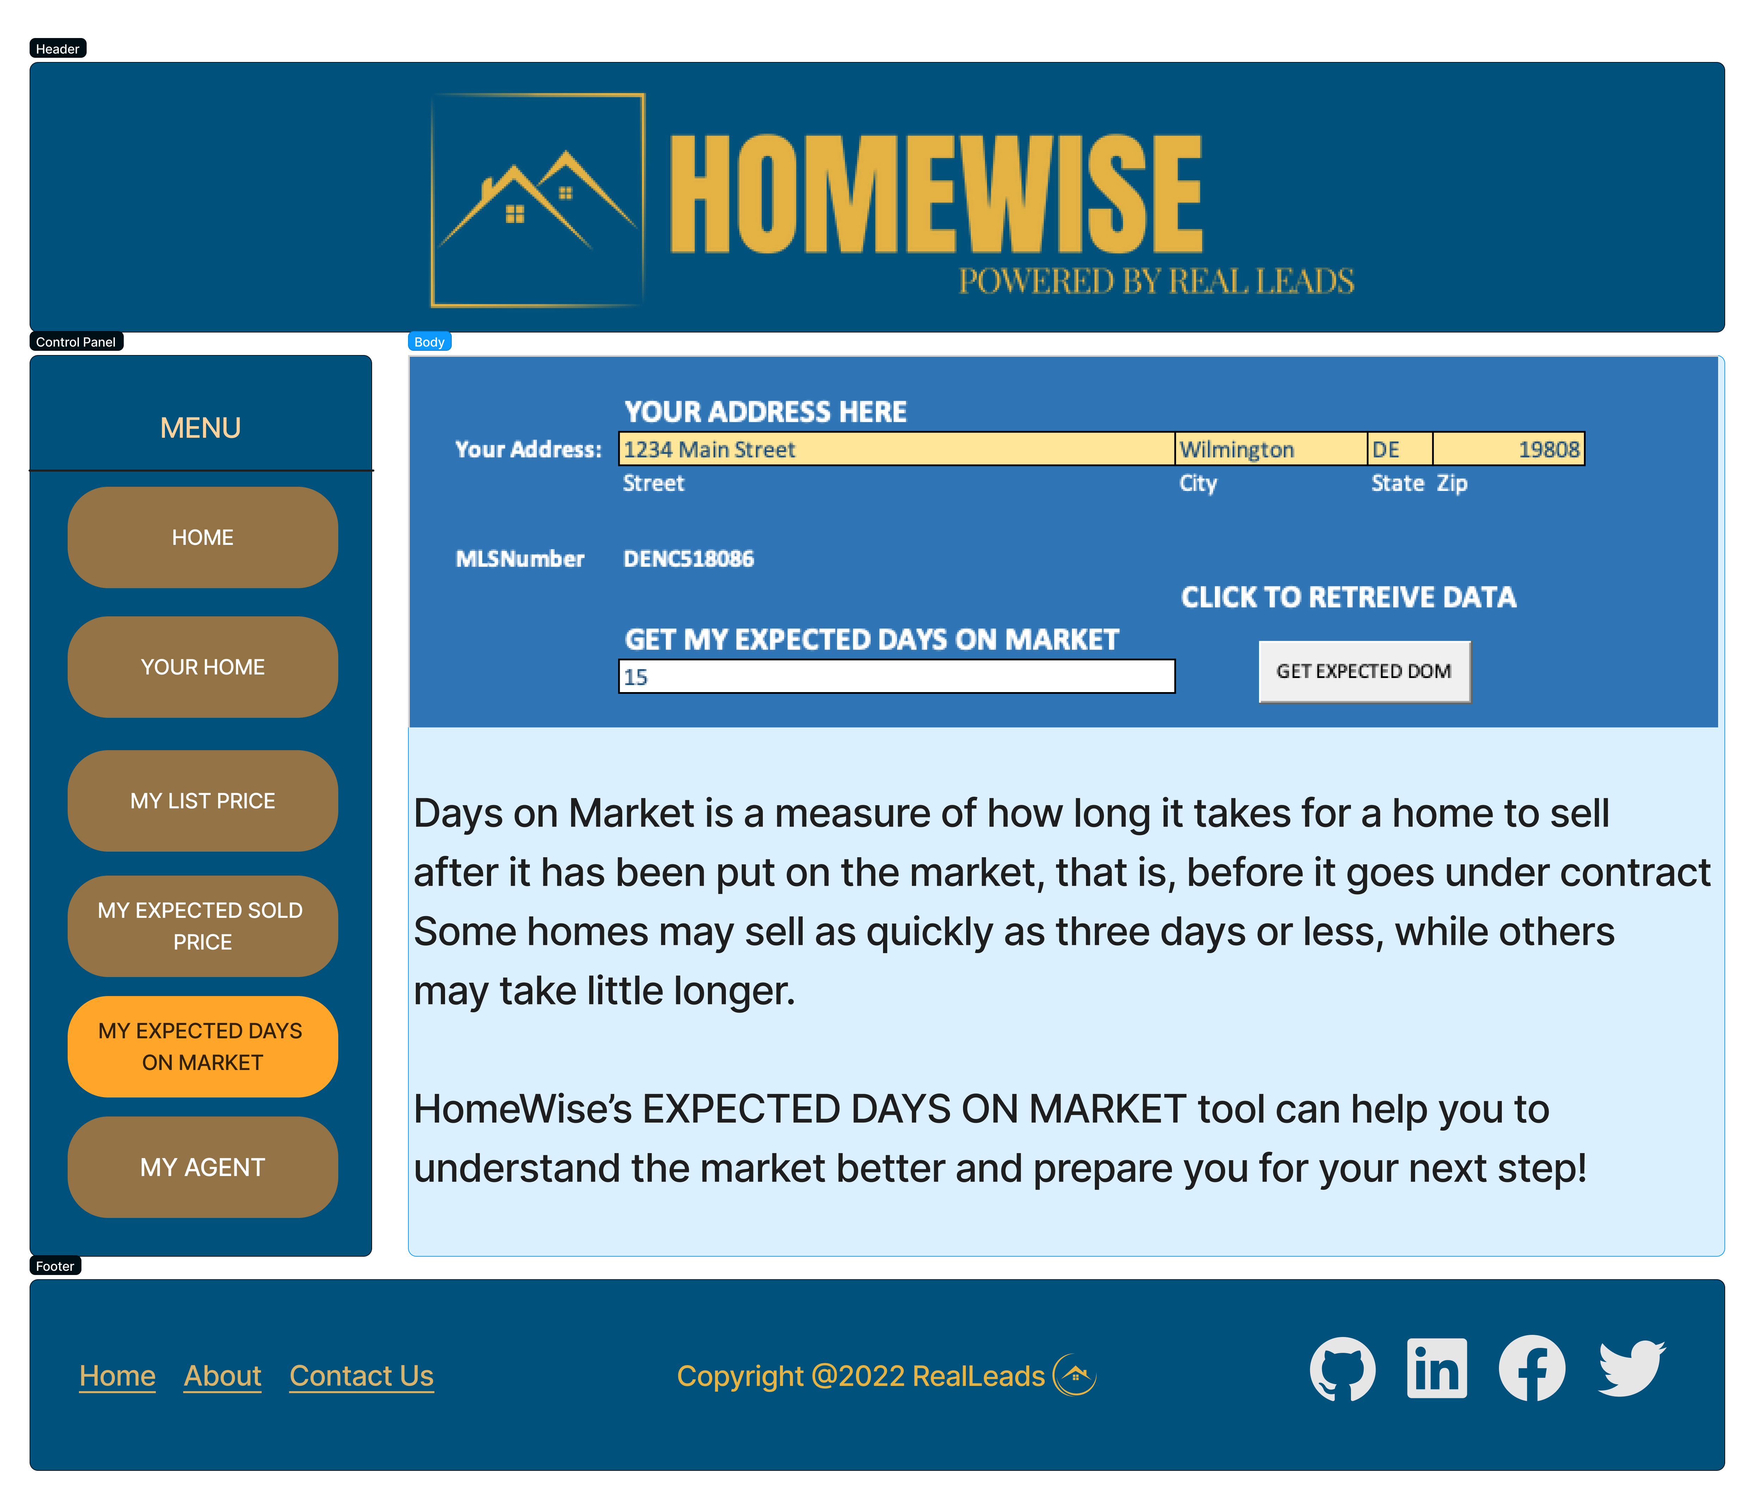

Slide 29
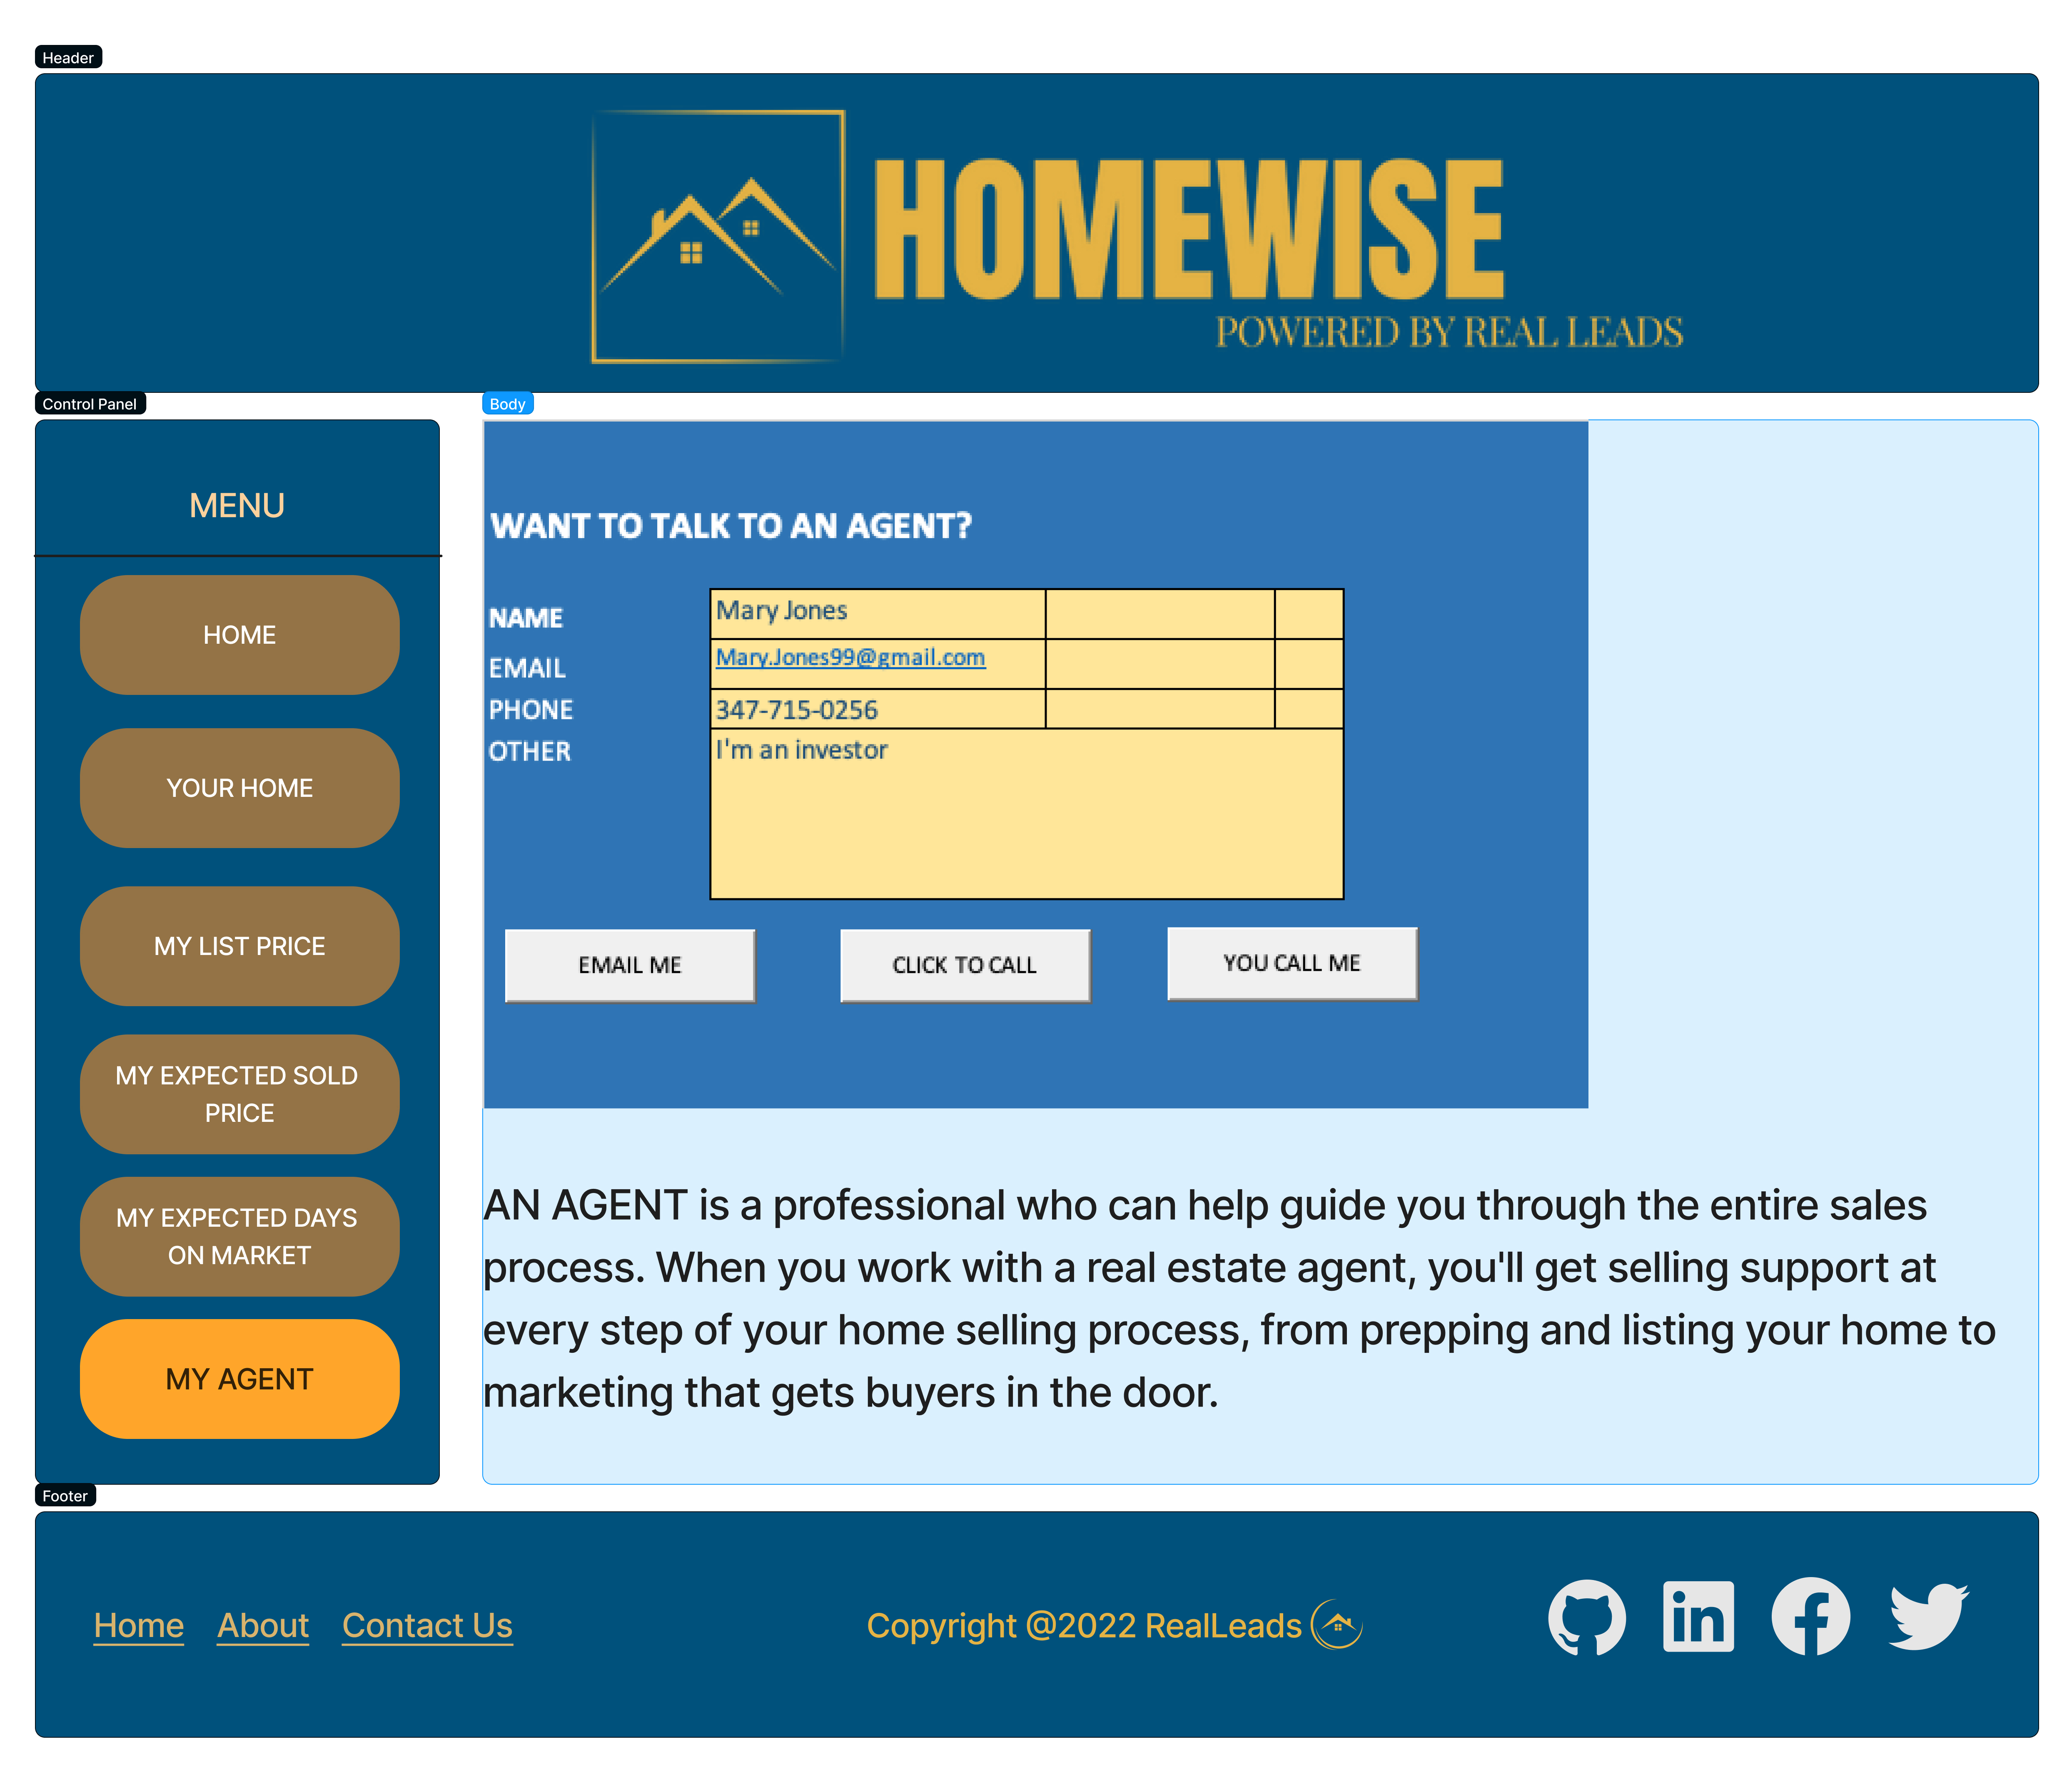

Slide 30
Net Income Opportunity for beta test
New Castle County Revenue Opportunity based on 600 Home Seller Leads (25% of annual sales units of 2,800) = $400K
Roll-out to Mid-Atlantic States Revenue = $9.4M
Annual Expenses for Development and Marketing = $(2.9)M
Net Income Before Tax = $6.5M

